Slide 1
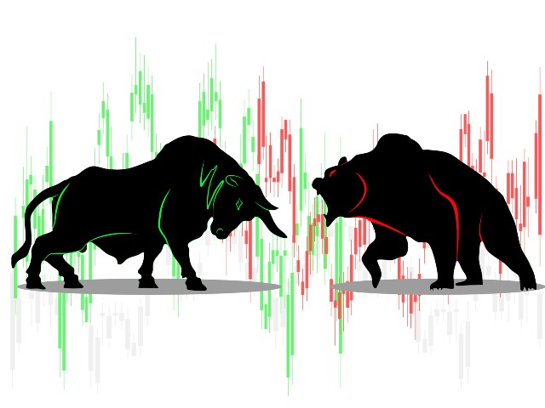
PREPARING FINANCIAL LAW STUDENTS FOR BULLS AND BEARS
CALESA – CLOSING SEMINAR (JAN 2024)
Miguel Azevedo Moura – NOVA School of Law

Slide 2
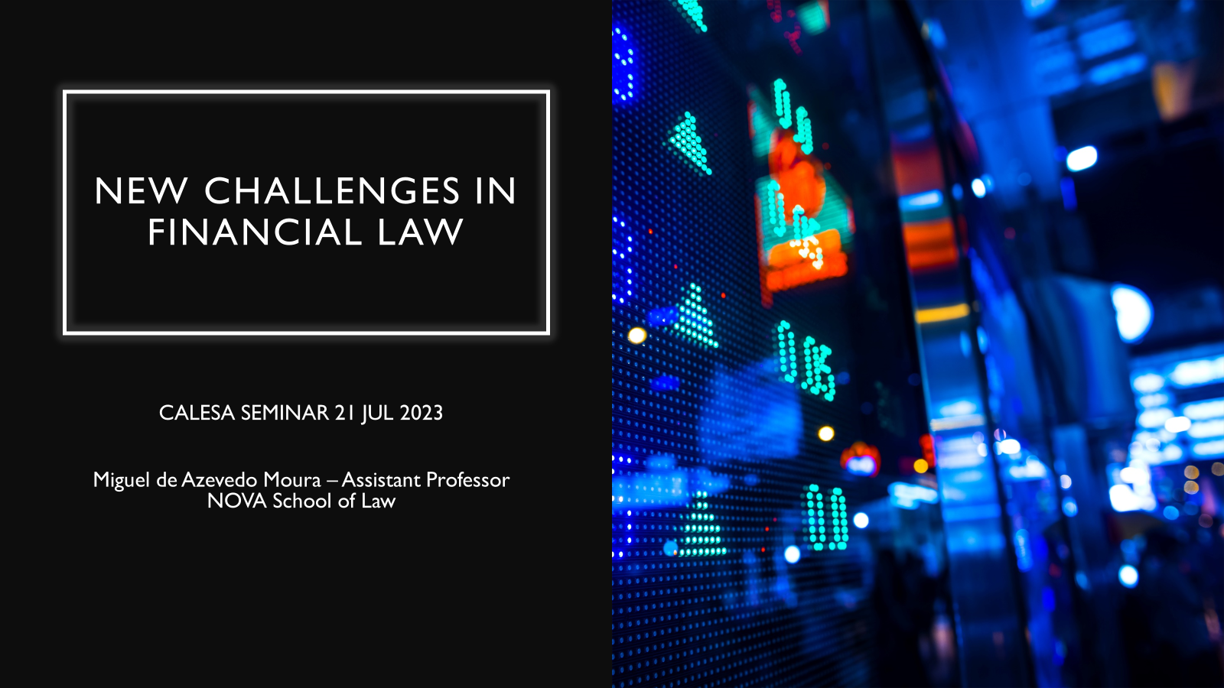
CALESA

Slide 3
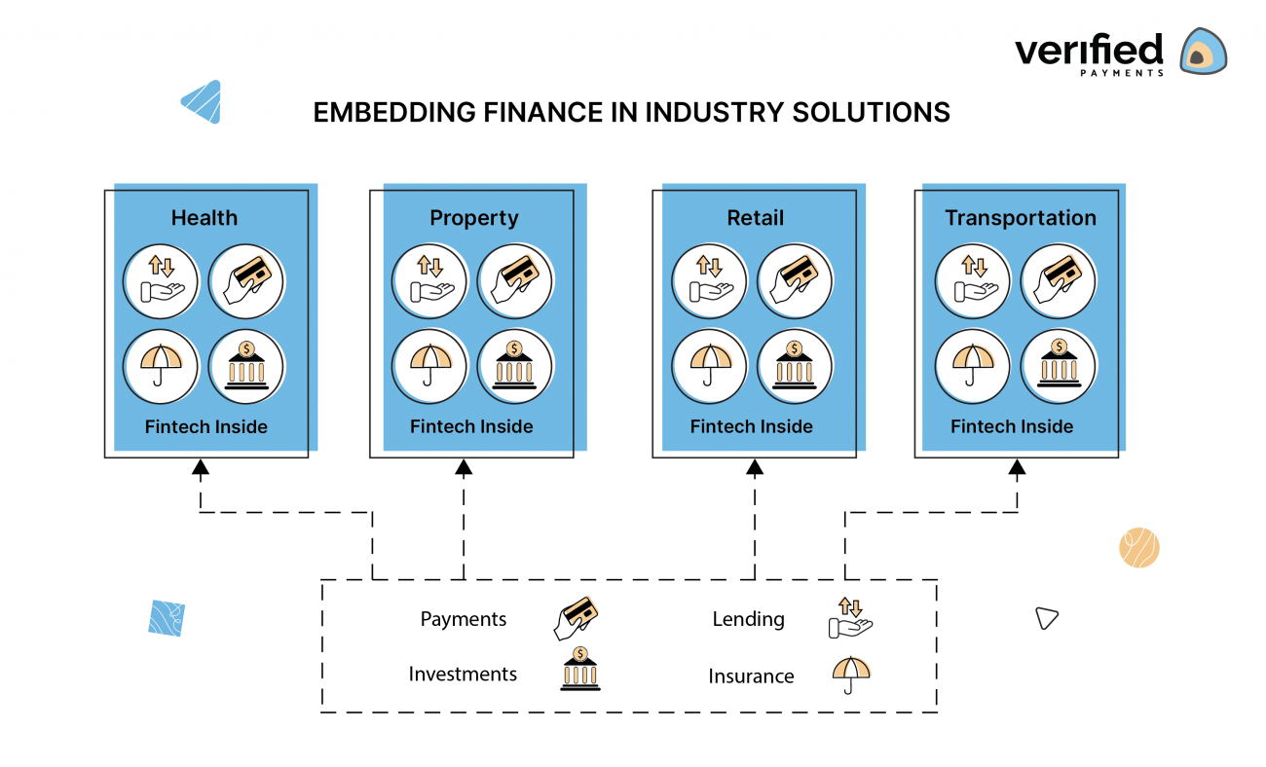
OPEN FINANCE

Slide 4
BNPL

Slide 5
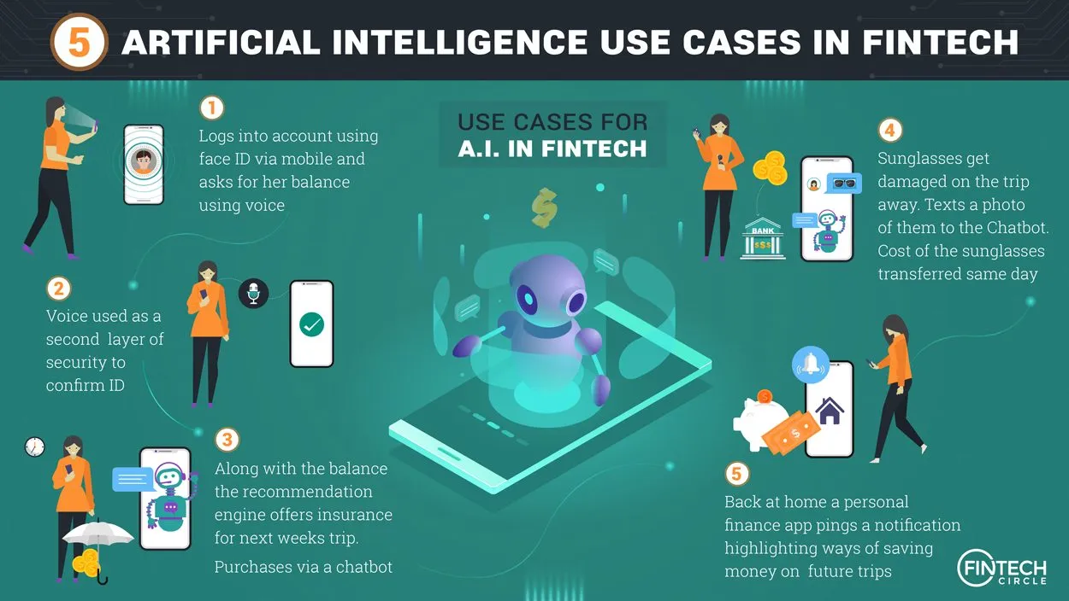
FIN AI
CREDIT SCORING
SUITABILITY & APPROPRIATENESS TESTS
RISK MANAGEMENT
FRAUD DETECTION
AML/KYC (SCREENING)
TRADING (HFT)
(PERSONAL) RECOMMENDATIONS
PORTEFOLIO MANAGEMENT
REGTECH (reg monitoring, reporting, compliance)

Slide 6
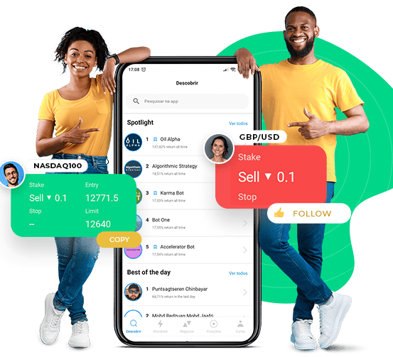
SOCIAL TRADING
FINTECH
CFD products
COPYTRADING

Slide 7
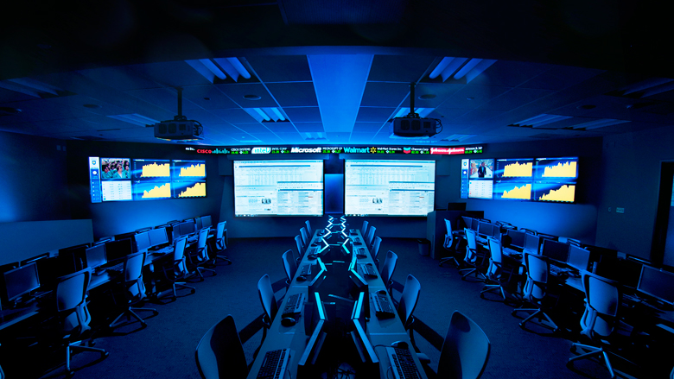

Slide 8
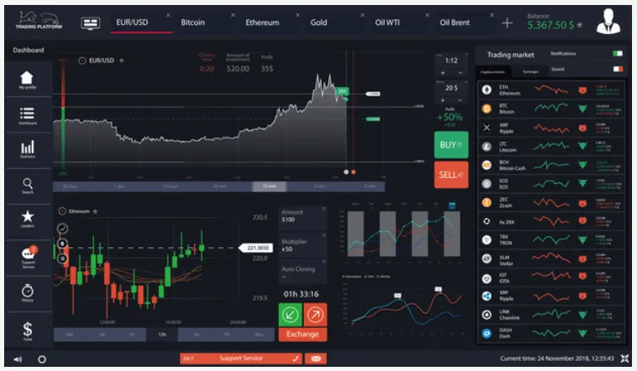

Slide 11
SOCIAL TRADING

