Slide 1
New Perspectives in Civil Law Consumer Protection in the Subscription Economy
Jorge Morais Carvalho
9 JANUARY 2024

Slide 2
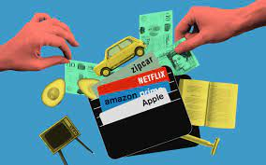
What is the subscription economy?

Slide 3
Challenges for Consumer Law
Transparency (clear choices in the pre-contractual phase; simple and straightforward cancellation mechanisms)
Fairness (auto-renewals and long-term inactive subscriptions)
Opportunity to ponder or reflect (right of withdrawal)
Balance
Conformity
Solvency
Market and innovation
Sustainability

Slide 4
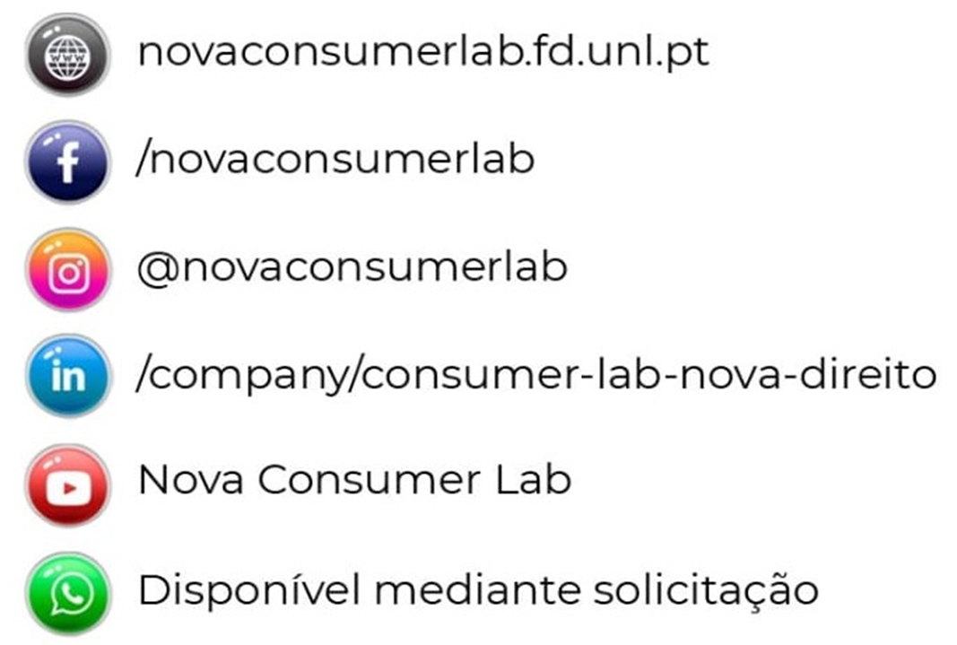
NOVA Consumer Lab
One of the almost 20 Knowledge Centres at NOVA School of Law.
Website: https://novaconsumerlab.novalaw.unl.pt.
A team of 22 researchers, including academics and professionals working in the field..
A wide range of activities related to Consumer Law, including scientific publications (books and articles) and publications for more general dissemination (Blog and Podcast), talks, conferences.

Slide 5
Muito obrigado!
9 JANUARY 2024

